Slide 1

An Aeroplan Dataset
An Aeroplan dataset was given to calculate the best time to travel and this also captured the following:
best day of the month
best day of the week and
best time of the day to travel.

Slide 2
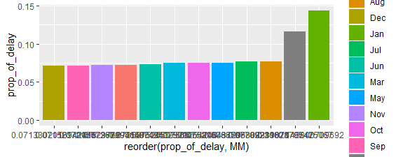
Best Month of the year to Travel

Slide 3
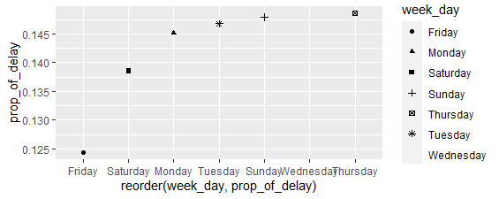
Best Day of the Week to Travel
Checking from the available data, Friday shows to be the best day of the month to travel by air in order to avoid delay

Slide 4
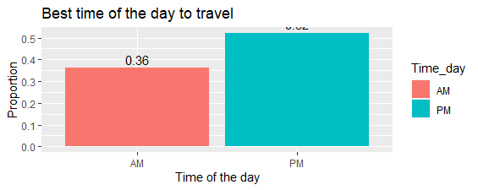

Slide 5
Thanks For Watching

